Slide 1

Front End Engineering-I Project
Team Details: 1) Name:- Divyansh Wadhwa
Roll No.:-2310991569
2) Name:- Gagandeep Singh
Roll No.:-2310991572
3) Name:- Garv Gupta
Roll No.:-2310991573
4) Name:- Gaurav Singh Heer
Roll No.:-2310991574
Faculty Coordinator: Simarjeet Kaur
Chitkara University Institute of Engineering and Technology,
Chitkara University, Punjab

Slide 2
Table of Contents
Introduction
Problem Statement
Technical Details
Key Features
Project Highlights
Bonus Feature
Conclusion

Slide 3
Introduction
Title-JavaScript Quiz Game
Team Details: 1) Name:- Divyansh Wadhwa 2) Name:- Gagandeep Singh
3) Name:- Garv Gupta 4) Name:- Gaurav Singh Heer
Overview:- Beginners Level Project That Focuses on Basics of HTML, CSS and JAVASCRIPT
Purpose and Goals:- To give us knowledge about how an actual frontend page of website is created

Slide 4
Problem Statement
AIM-To Build A Quiz Game Using JavaScript

Slide 5
Technical Details
Platform Used:- VS Code
Programming Languages Used:-1)HTML
2)CSS

Slide 6
Key Features
input type radio tag. (To select option in quiz)
meta viewport tag. (To give webpage width as of device being used)
media tag. (To format page as device being used)
Table tag. (To give solution of quiz game)
th tag(to give table heading), tr tag(to give new row to table), td tag(to add data in table)

Slide 7
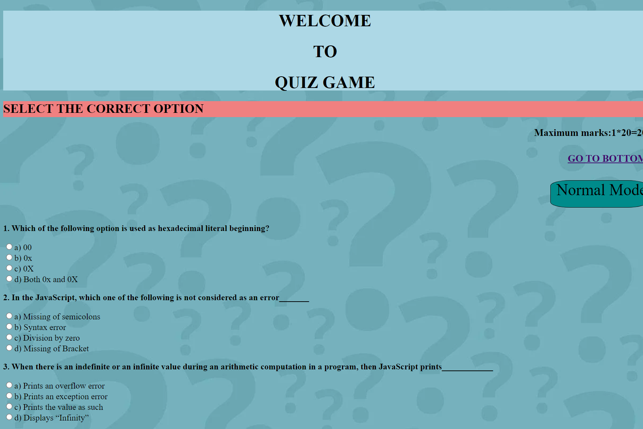
Project Highlights [Quiz Game Tab] Tab]
This slide followed by many slides include the relevant screenshots of the running project and their corresponding code snippets.
It should frame the complete picture of your solution.
IMP SCREENSHOT

Slide 8
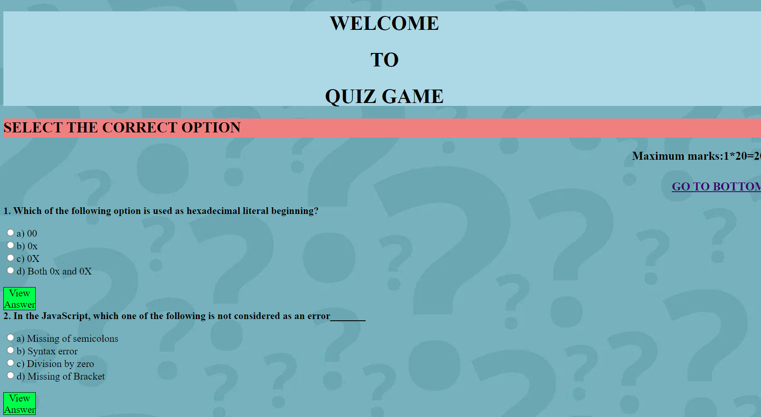
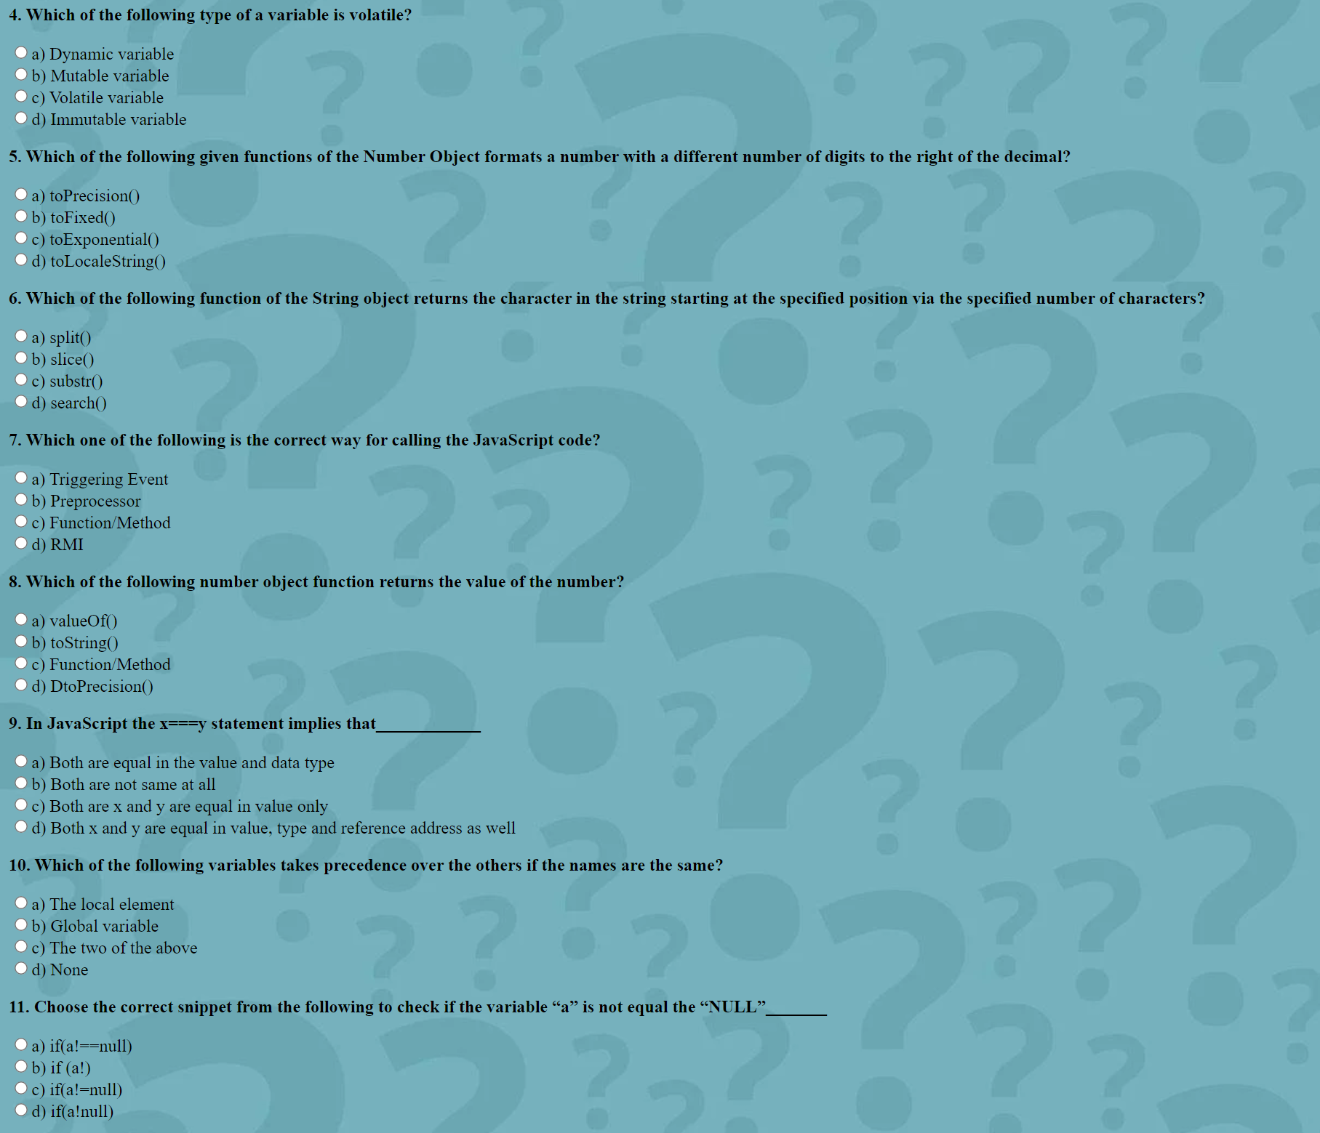
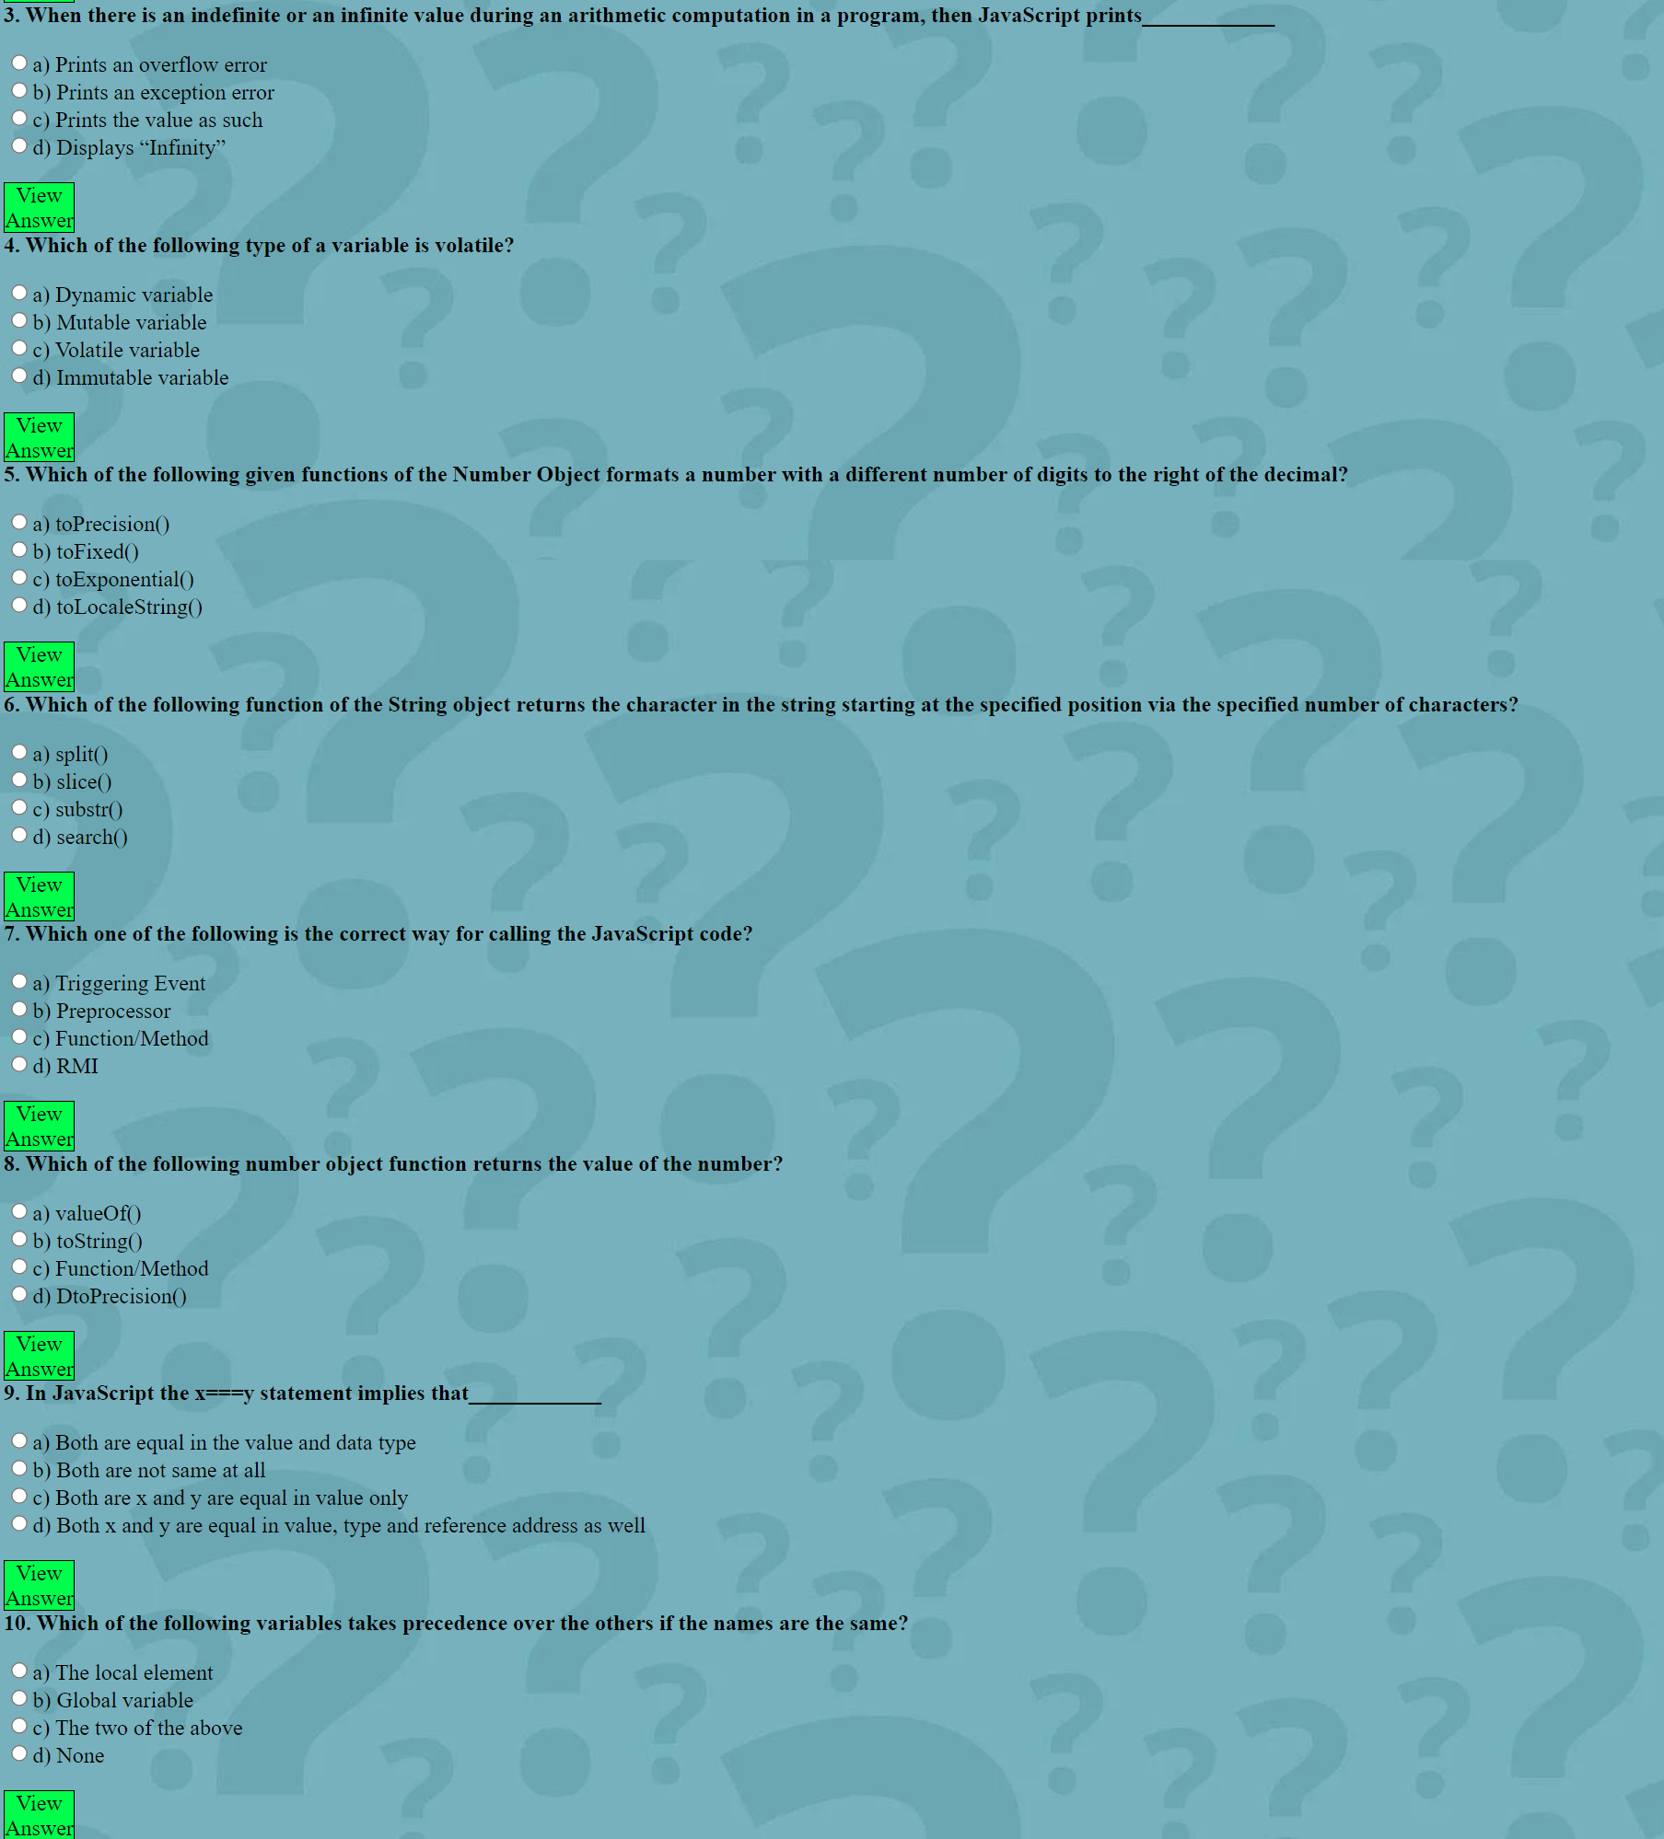
Project Highlights [Quiz Game Tab] Tab]
This slide followed by many slides include the relevant screenshots of the running project and their corresponding code snippets.
It should frame the complete picture of your solution.
IMP SCREENSHOT

Slide 9
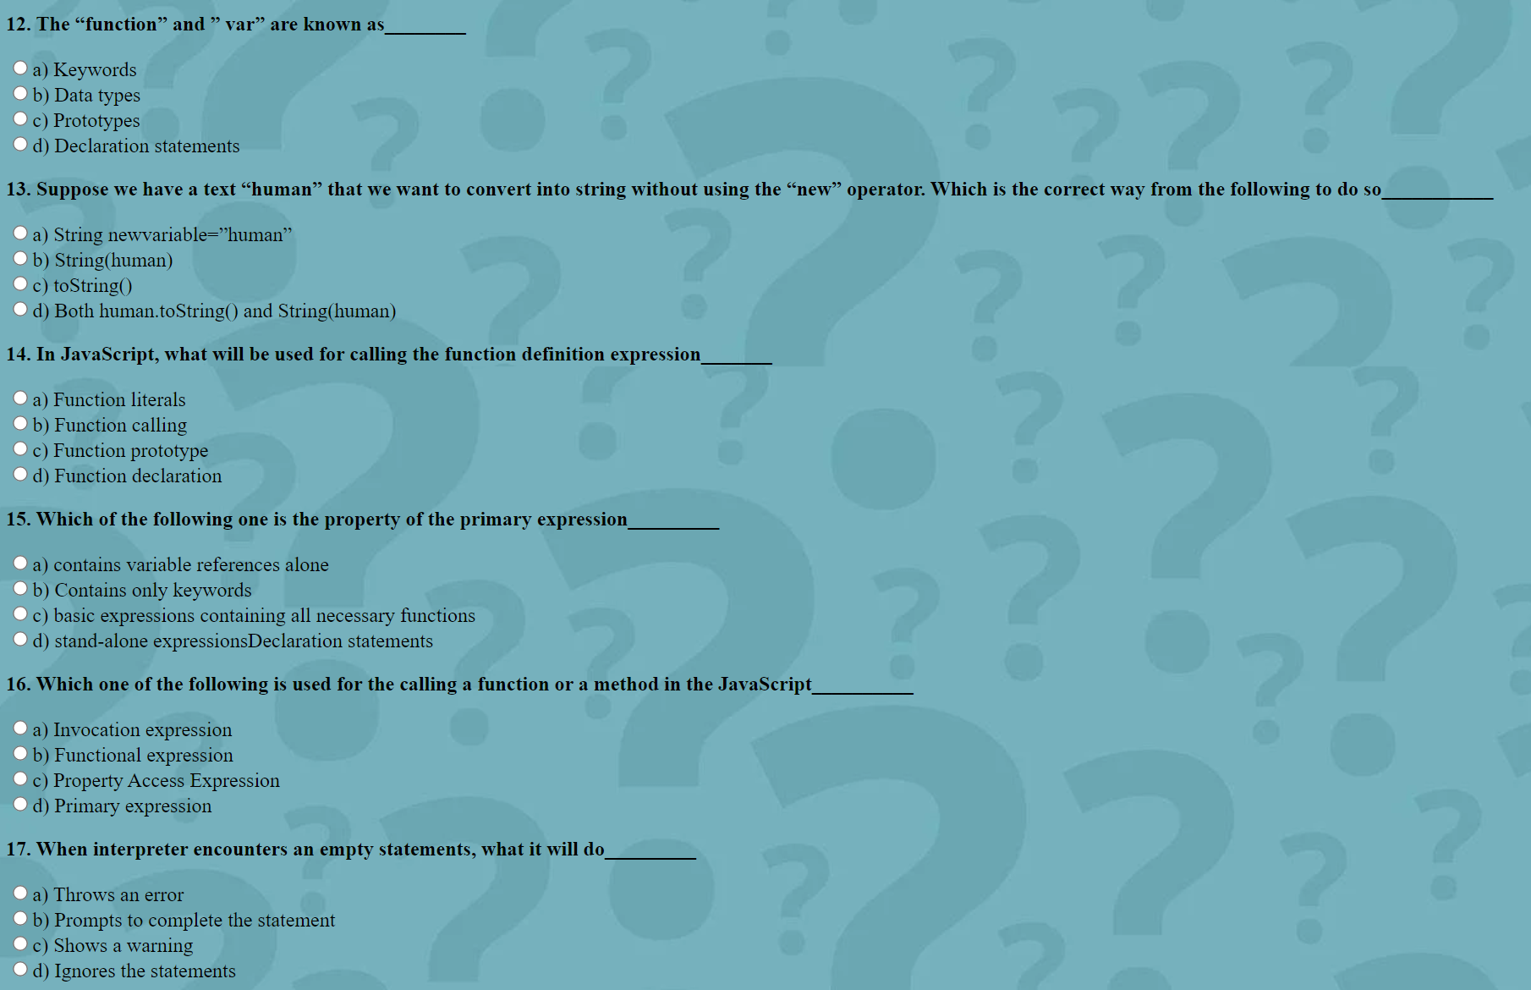
Project Highlights [Quiz Game Tab] Tab]
This slide followed by many slides include the relevant screenshots of the running project and their corresponding code snippets.
It should frame the complete picture of your solution.
IMP SCREENSHOT

Slide 10
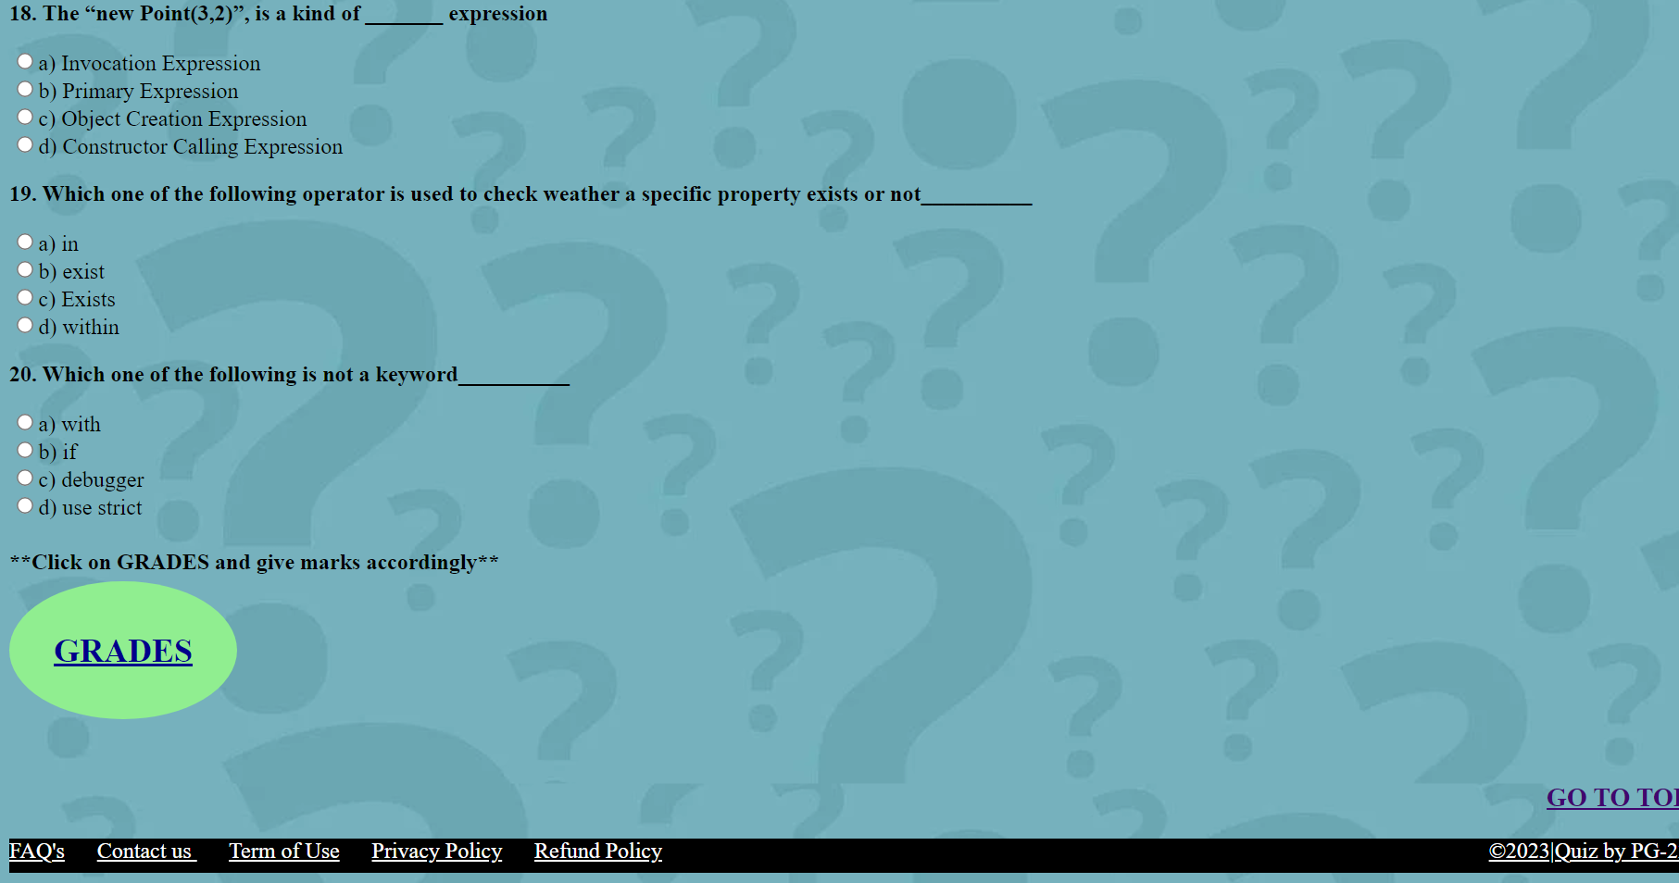
Project Highlights [Quiz Game Tab]

Slide 11
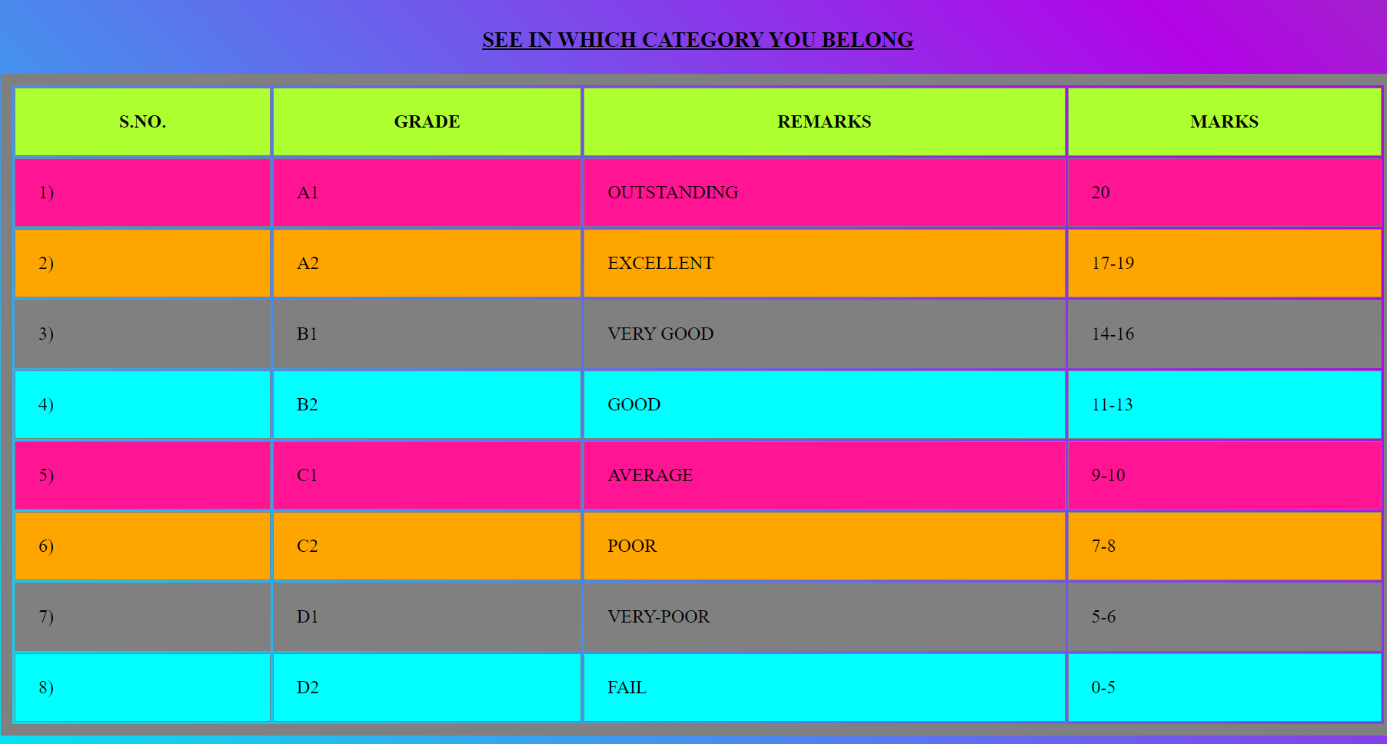
Project Highlights [Grade in Solution Tab]

Slide 12
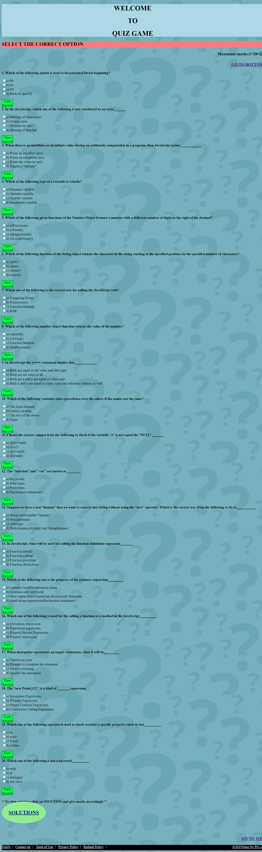
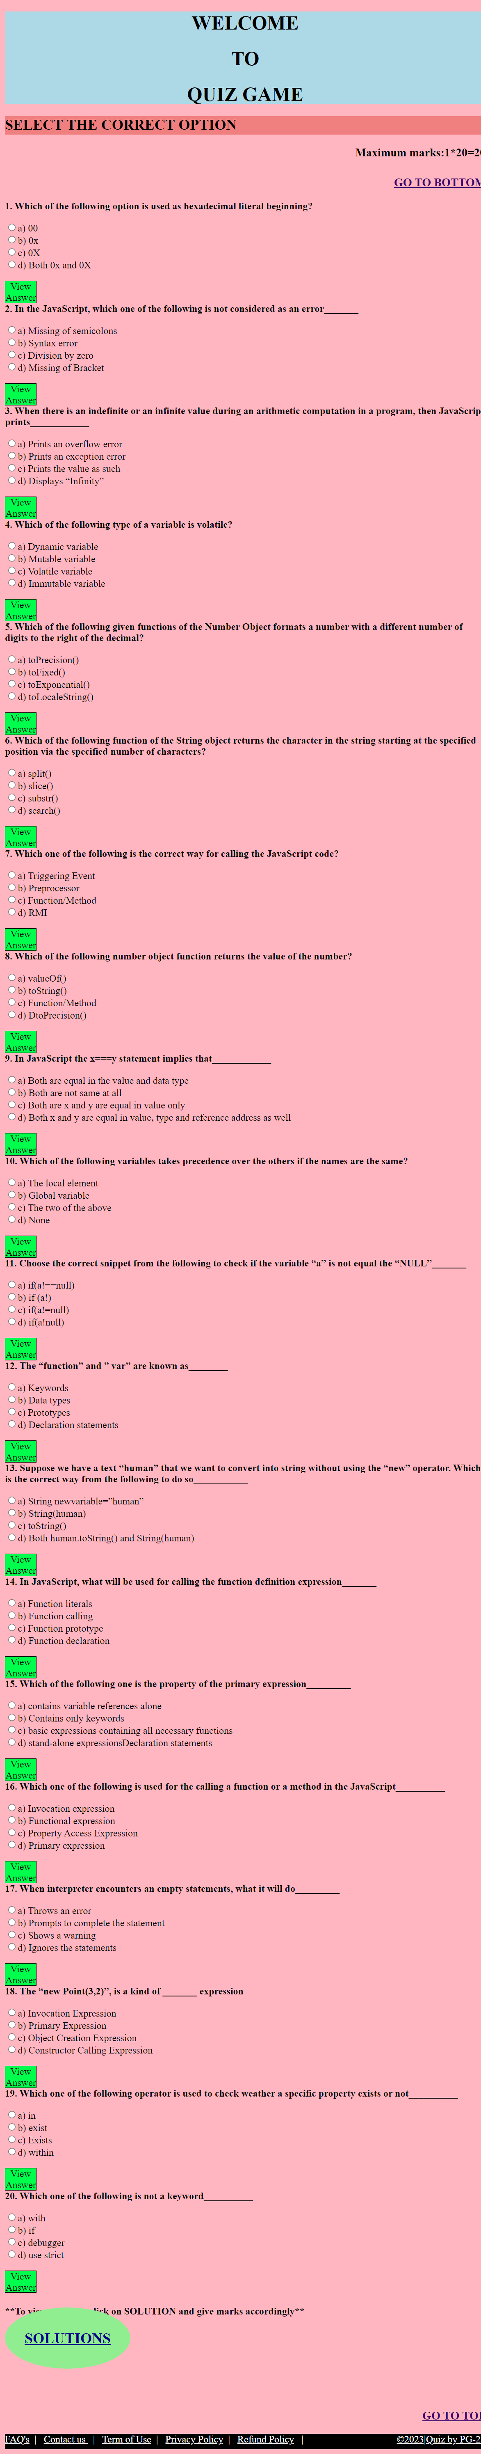
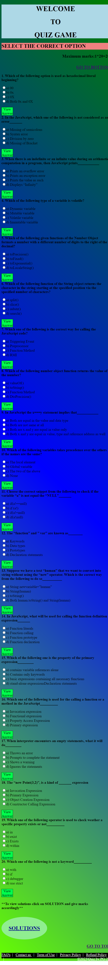
Project Highlights [Normal Mode quiz game]
For width:- 801px-1500px | For width:- 501x-800px | For width:- 150px-500px

Slide 13
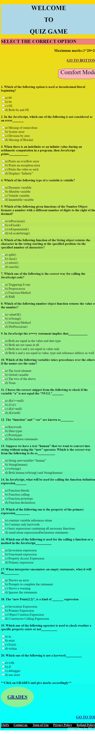
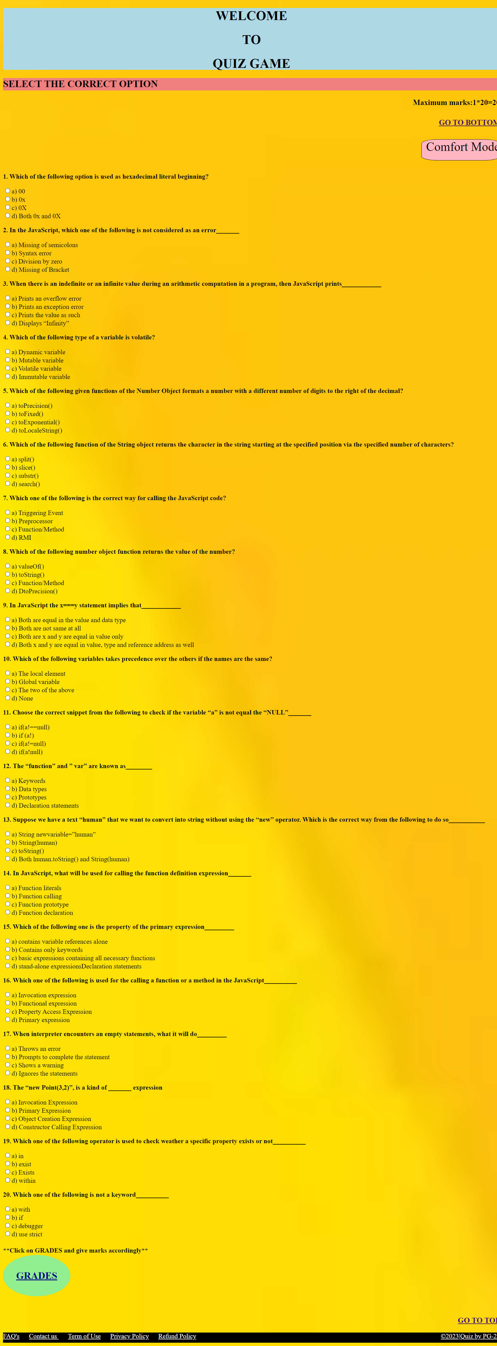
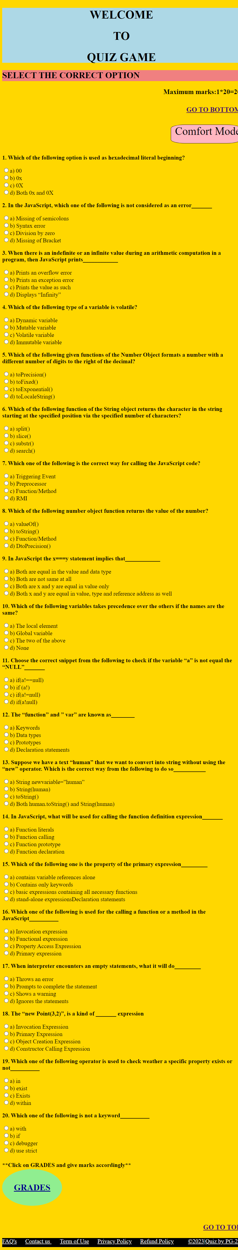
Project Highlights [Comfort Mode quiz game]
For width:- 801px-1500px | For width:- 501x-800px | For width:- 100px-500px

Slide 14
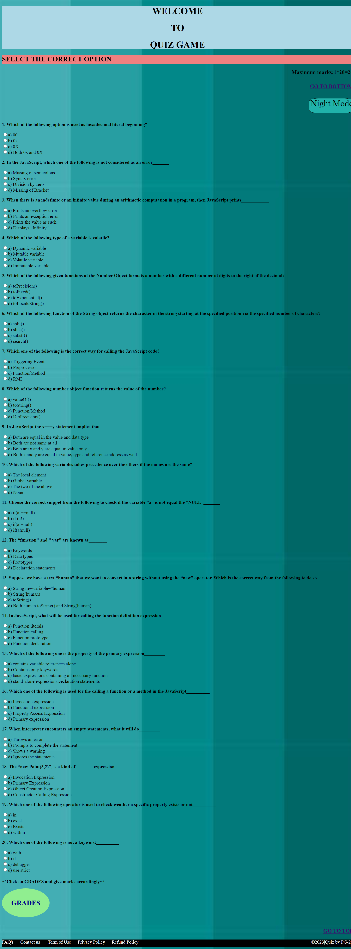
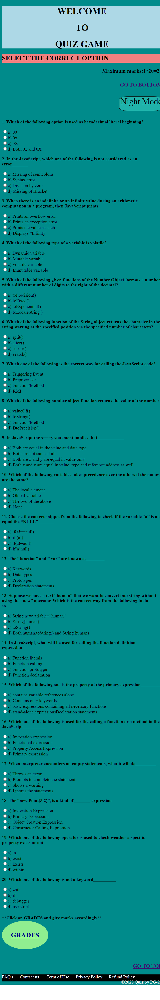
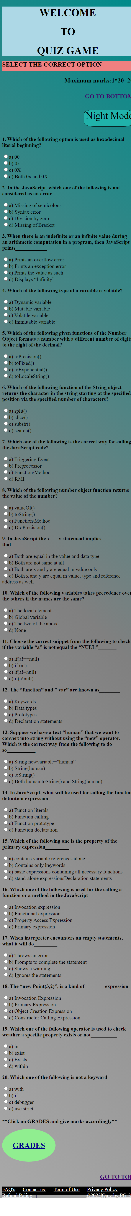
Project Highlights [Night Mode quiz game]
For width:- 801px-1500px | For width:- 501x-800px | For width:- 150px-500px

Slide 15
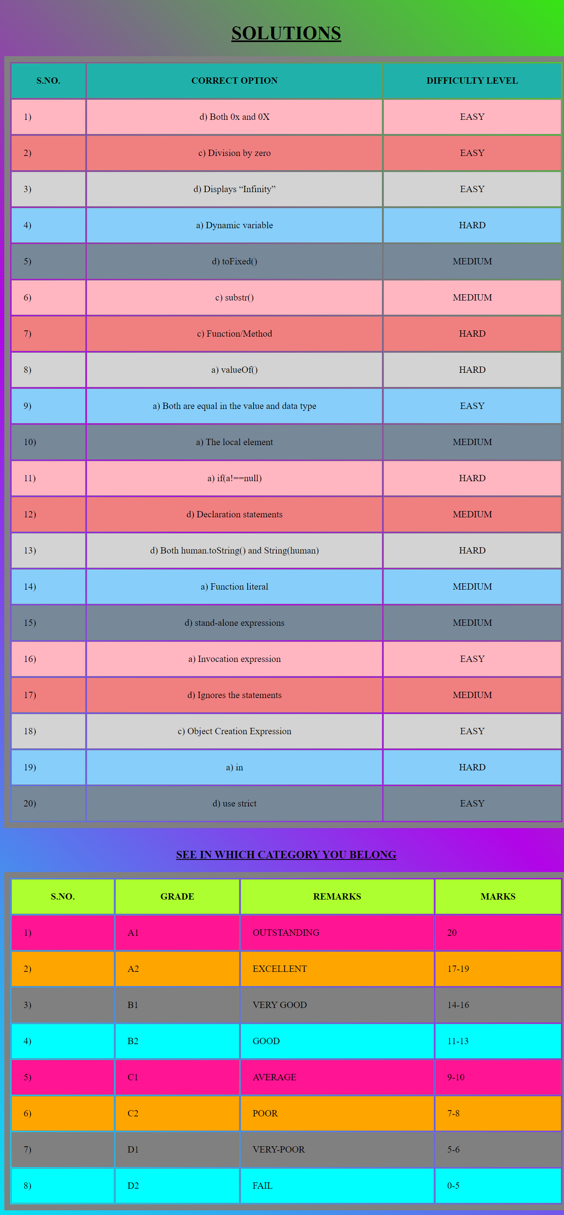
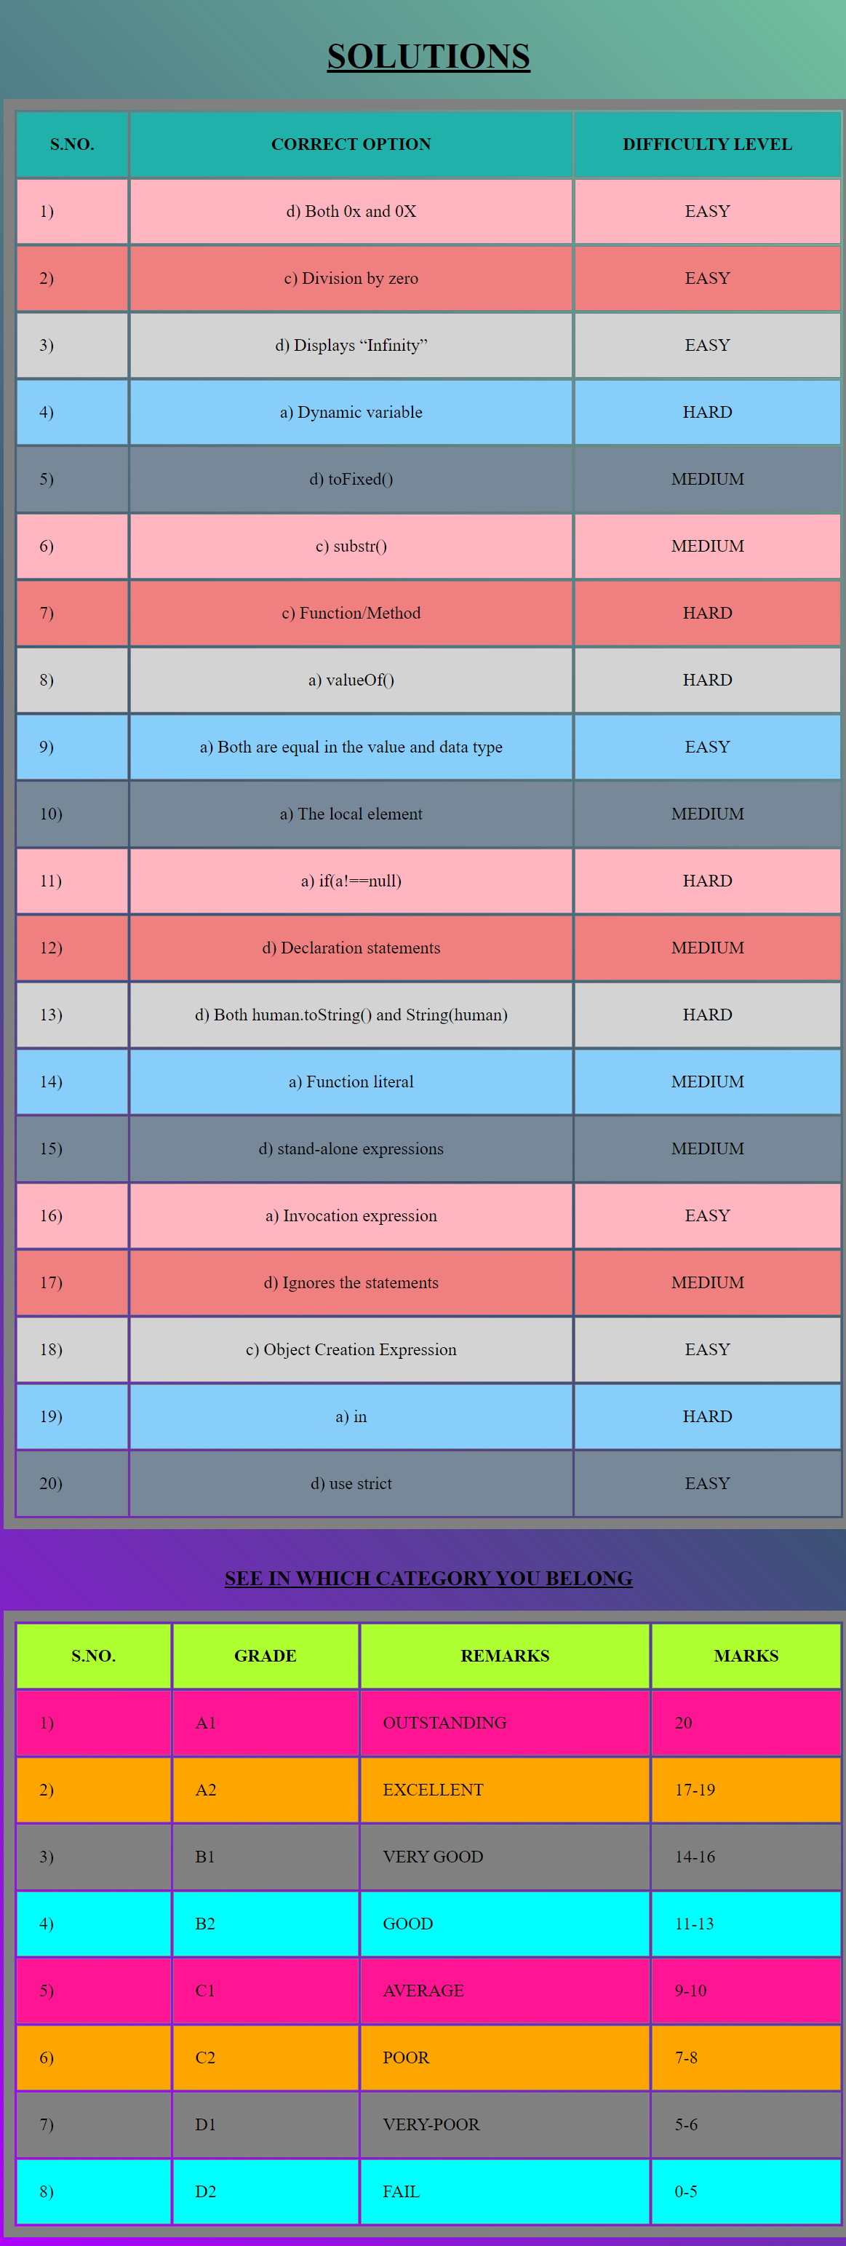
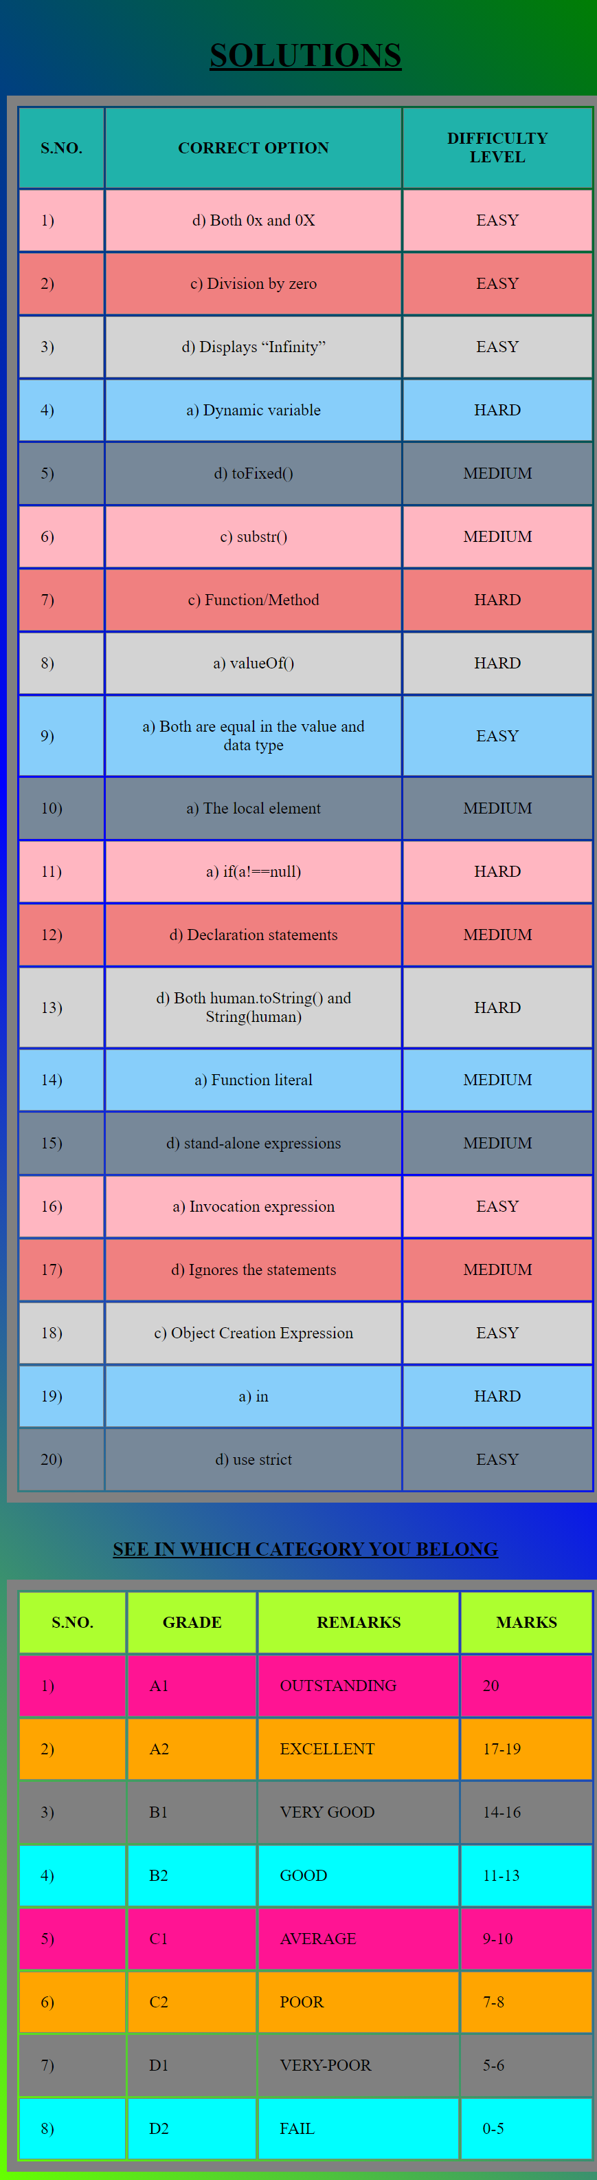
Project Highlights [Media in Solution Tab]
For width:- 801px-1500px | For width:- 601px-800px | For width:- 150px-600px

Slide 16
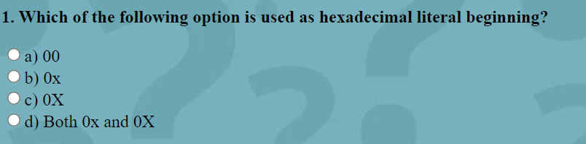
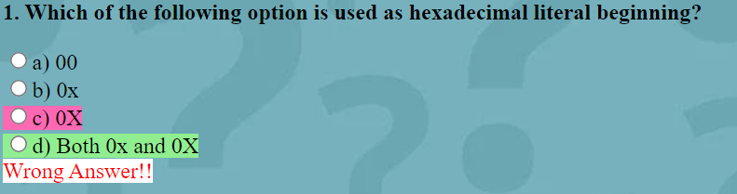
Bonus Feature
We added a feature that allow candidate to check whether his/her answer is correct or not .It will help candidate to save his/her time to check
Their answer
NORMAL
ON HOVER

Slide 17
Conclusion
By making this project we got basic idea how front-end of web page is made.
In making of this project all team members have contributed equally
~Submitted By:-PG-22

Slide 18



